Slide 1
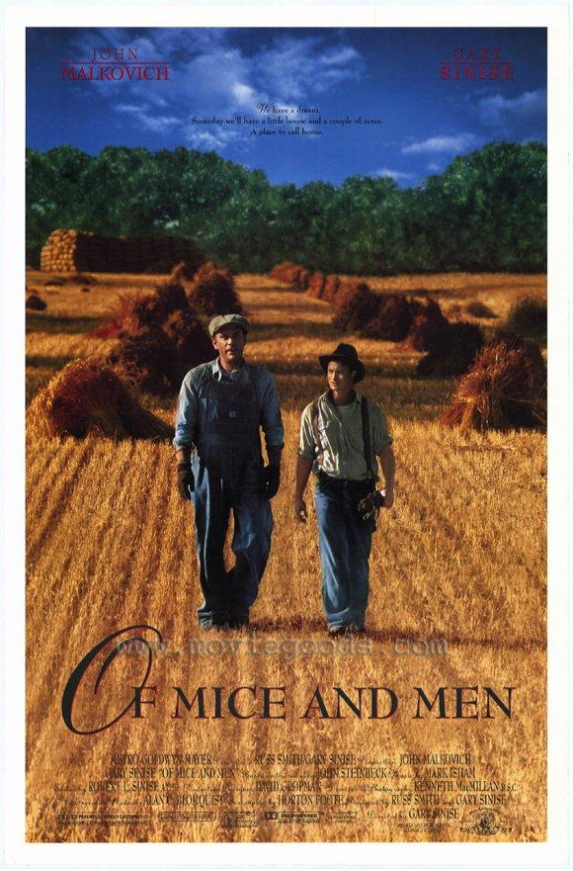
OF MICE AND MEN
By John Steinbeck
An introduction for
Year 9 English

Slide 2
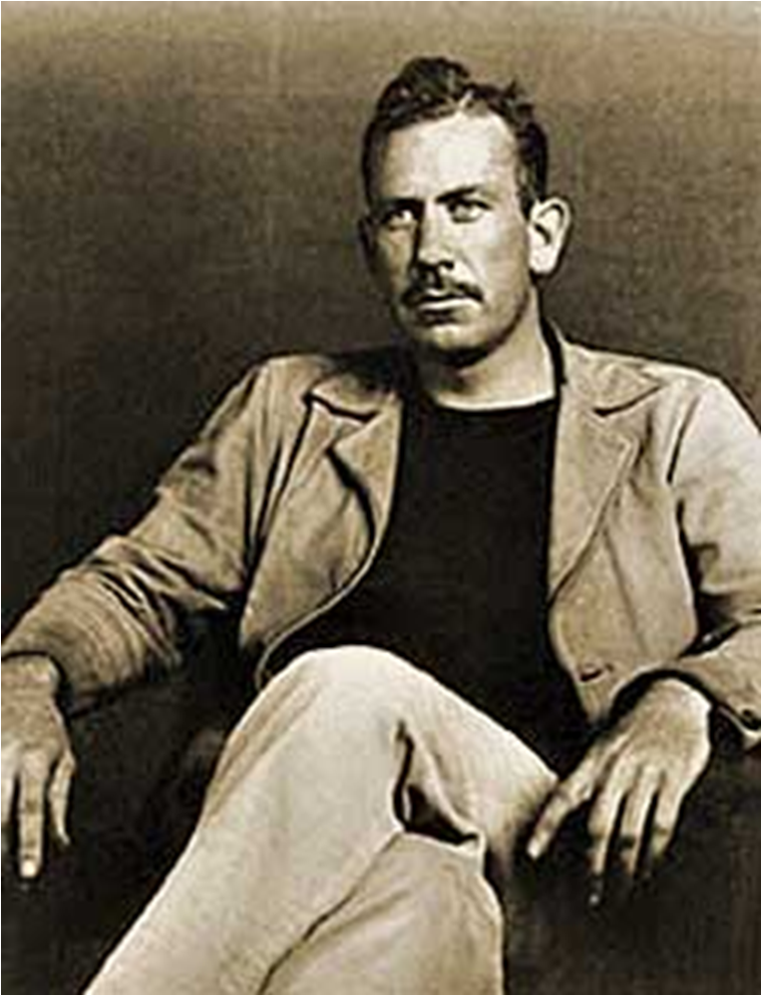
This is John Steinbeck
He is considered one of the most important of American authors
Notes:
This is John Steinbeck
This is John Steinbeck. He is considered one of the most important of American authors

Slide 3
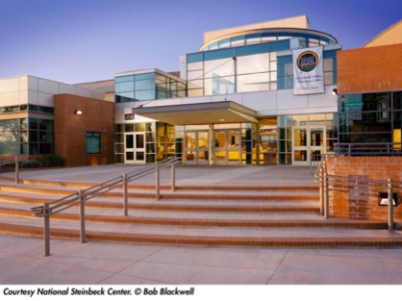
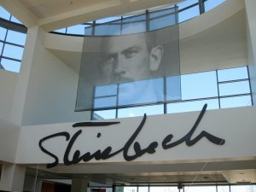
He is such a revered and loved author that he has his own museum : “The Steinbeck Centre” in California.
The reception area is actually his childhood home!

Slide 4
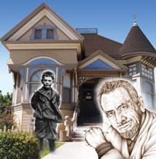
Steinbeck is from German and Irish descent.
His mum was a school teacher and she encouraged his love of literature.

Slide 5
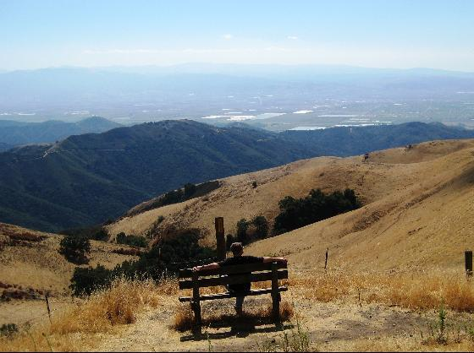
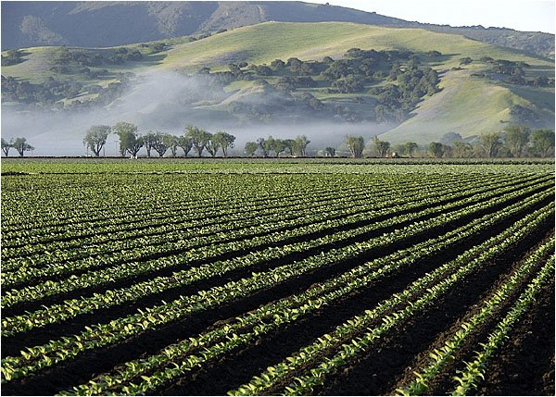
Salinas Valley, California where Steinbeck grew up
(Looks a lot like Australia!)
In his summer holidays Steinbeck worked here as a ranch hand

Slide 6
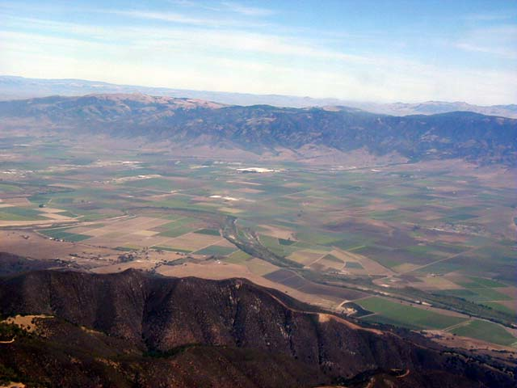
It is the Salinas Valley and life on the land that he captures in his novels and inspires the world.

Slide 7
This famous author went to Stanford University in 1919
He is a really slack student. He wags class and NEVER GOT A DEGREE. In 1925 he leaves Uni for good and runs off to....

Slide 8
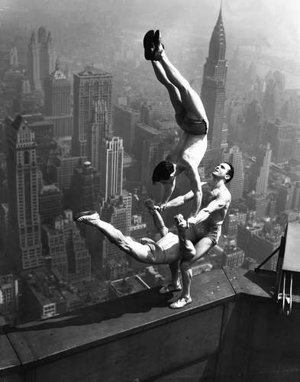
New York !

Slide 9
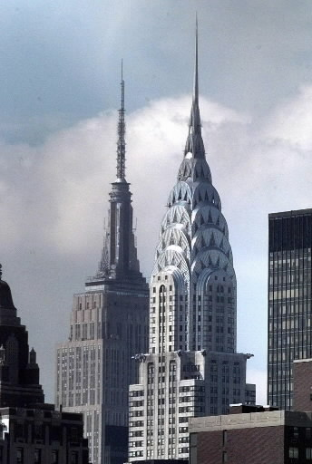
His dream is to be a writer but he fails and goes back to California.

Slide 10
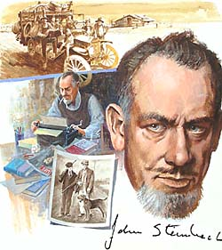
His first novels were not received well critically

Slide 11
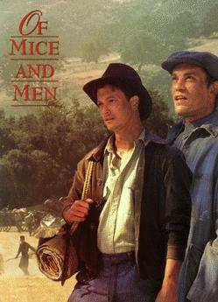
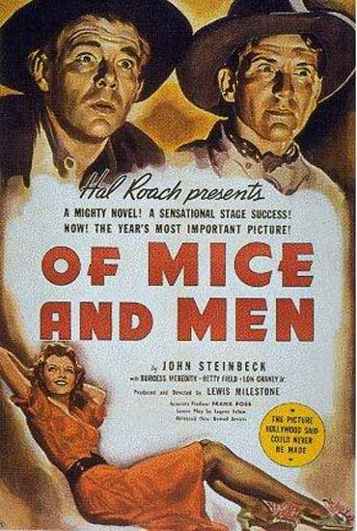
With the publication of his first novella- a short novel in 1937.
He gains world wide recognition. He goes on to write other powerful novels. (Grapes of Wrath)
In 1962 he wins the Nobel Prize for Literature.

Slide 12
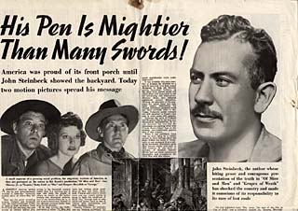

Slide 13
This is the original cover for the book in 1937.
Looking at the cover what do you think it might be about?

Slide 14
Big deal!
I hate reading my English books. So why should I read this book?

Slide 15
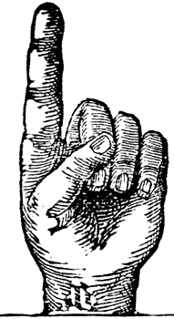
There are several reasons why you should read this book. Let me try & persuade you.

Slide 16
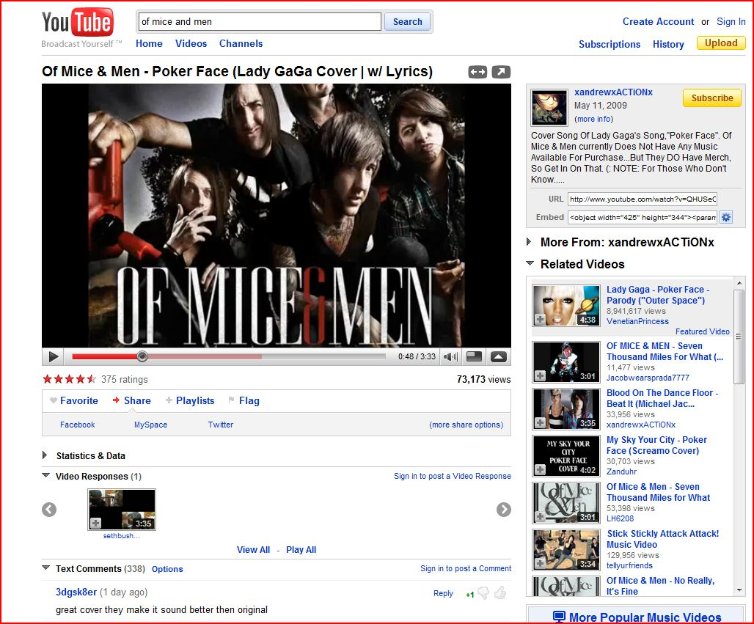
Reason 1:This book is cool!

Slide 17
Megadeth have a song called “Of Mice and Men” on their “The system has failed” album.

Slide 18
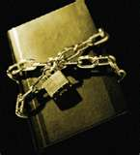
Reason 2:THIS BOOK IS OFTEN CENSORED
Even though Of Mice and Men is considered an American classic.
It is one of the most banned books
in American schools.

Slide 19
Constantly this book is complained about by parent groups in America. So what makes the book so controversial?

Slide 20
It is banned because of its language:
Examples:
Son of a bitch
Whore
Bastard
The “n” word

Slide 21
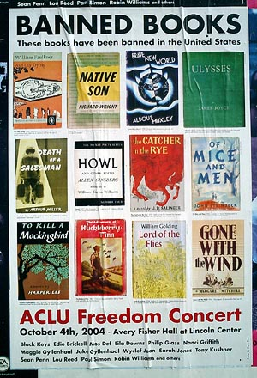
Here are some examples of other banned literature in American schools.

Slide 22
Of Mice and Men is controversial because of the way it depicts
women

Slide 23
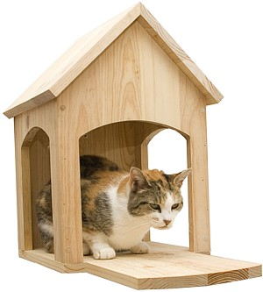
The book is also censored because the characters are rough & tough ranch hands. They spend most of their free time drinking alcohol and visiting prostitutes in what is known as a
“cat-house”.

Slide 24
Reason 3:
Of Mice and Men is only around 100 pages long.
An easy read!

Slide 25
Reason 4:
Of Mice and Men has a great story.
It is suspenseful with a shock ending.

Slide 26
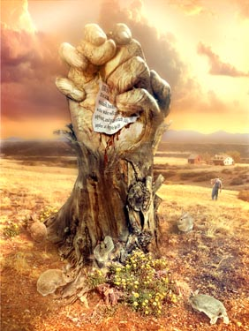
It’s about dreams, friendship, loneliness & violence

Slide 27
Reason 5
Reading some books makes you a better
person and this is one of them!

Slide 28
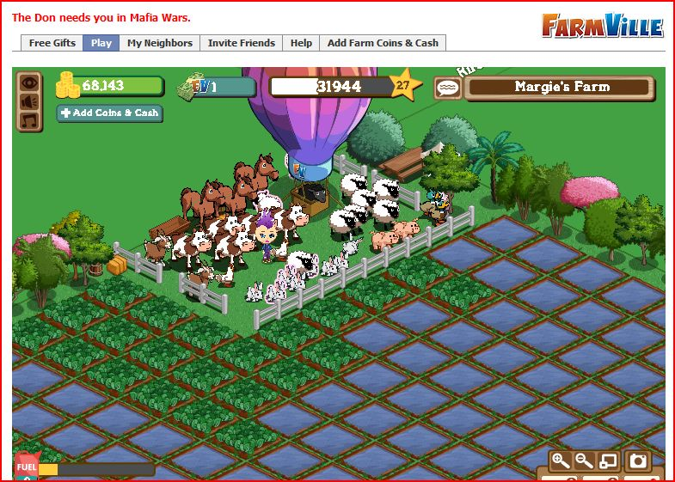
Before you read here is a little background information about farm life in America in the mid 30s.
Farm life today!

Slide 29
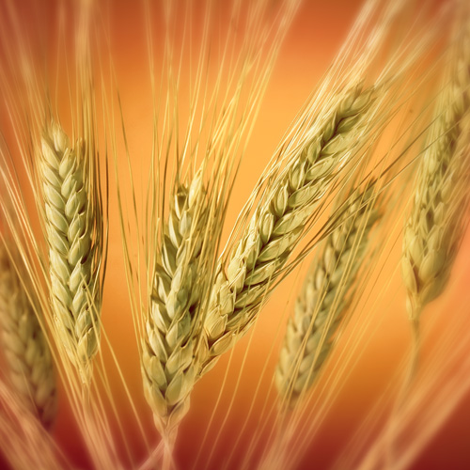
Before the 30s farm life was booming in America. Farmers were trying to cash in on the biggest crop of the day: wheat!

Slide 30
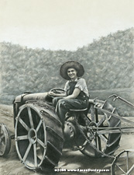
With the invention of better tractors, farmers could go crazy ploughing the land.
And they did.

Slide 31
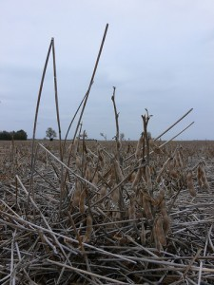
In those days they didn’t know a lot about soil conservation. When the crops failed year after year because of drought there was nothing holding the soil in place.

Slide 32
What happens to loose dry dirt in a big wind?

Slide 33
Dust!

Slide 34
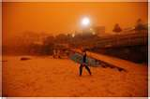
Dust storm Sydney
23 September 2009
Strong winds had blown the dust from
Central Australia

Slide 35
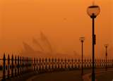
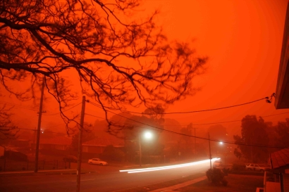
The view in suburban Sydney at 5:45 am this morning (23 September 2009). Sydneysiders awoke to a strange red glow in the sky.

Slide 36
Okay that was bad in Sydney but check out the dirty 30s in
America

Slide 37
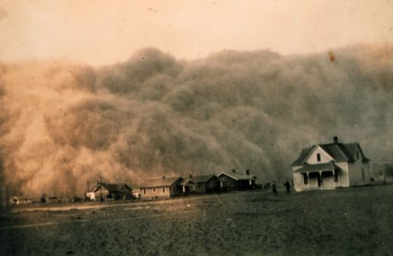
The Prairie winds made many dust storms

Slide 38
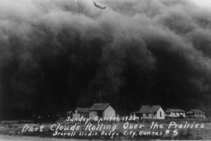
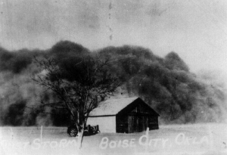
Black Sunday April 14, 1935. The dust storm that turned day into night. Many believed the world was coming to an end.

Slide 39
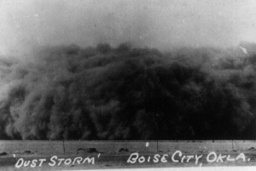

Slide 40
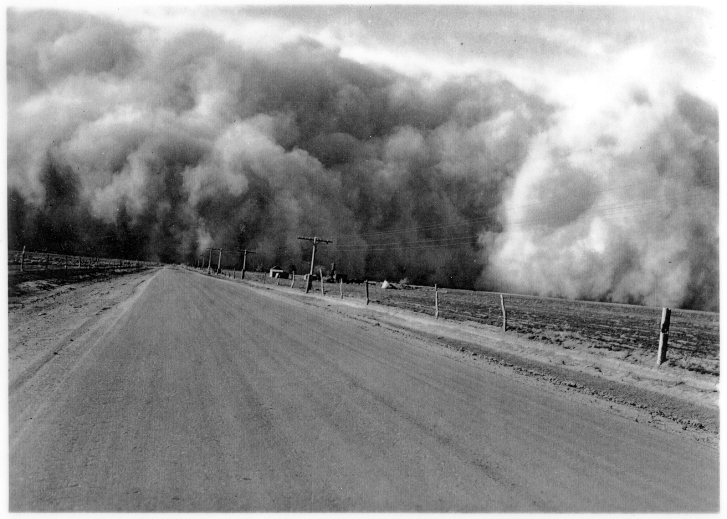

Slide 41
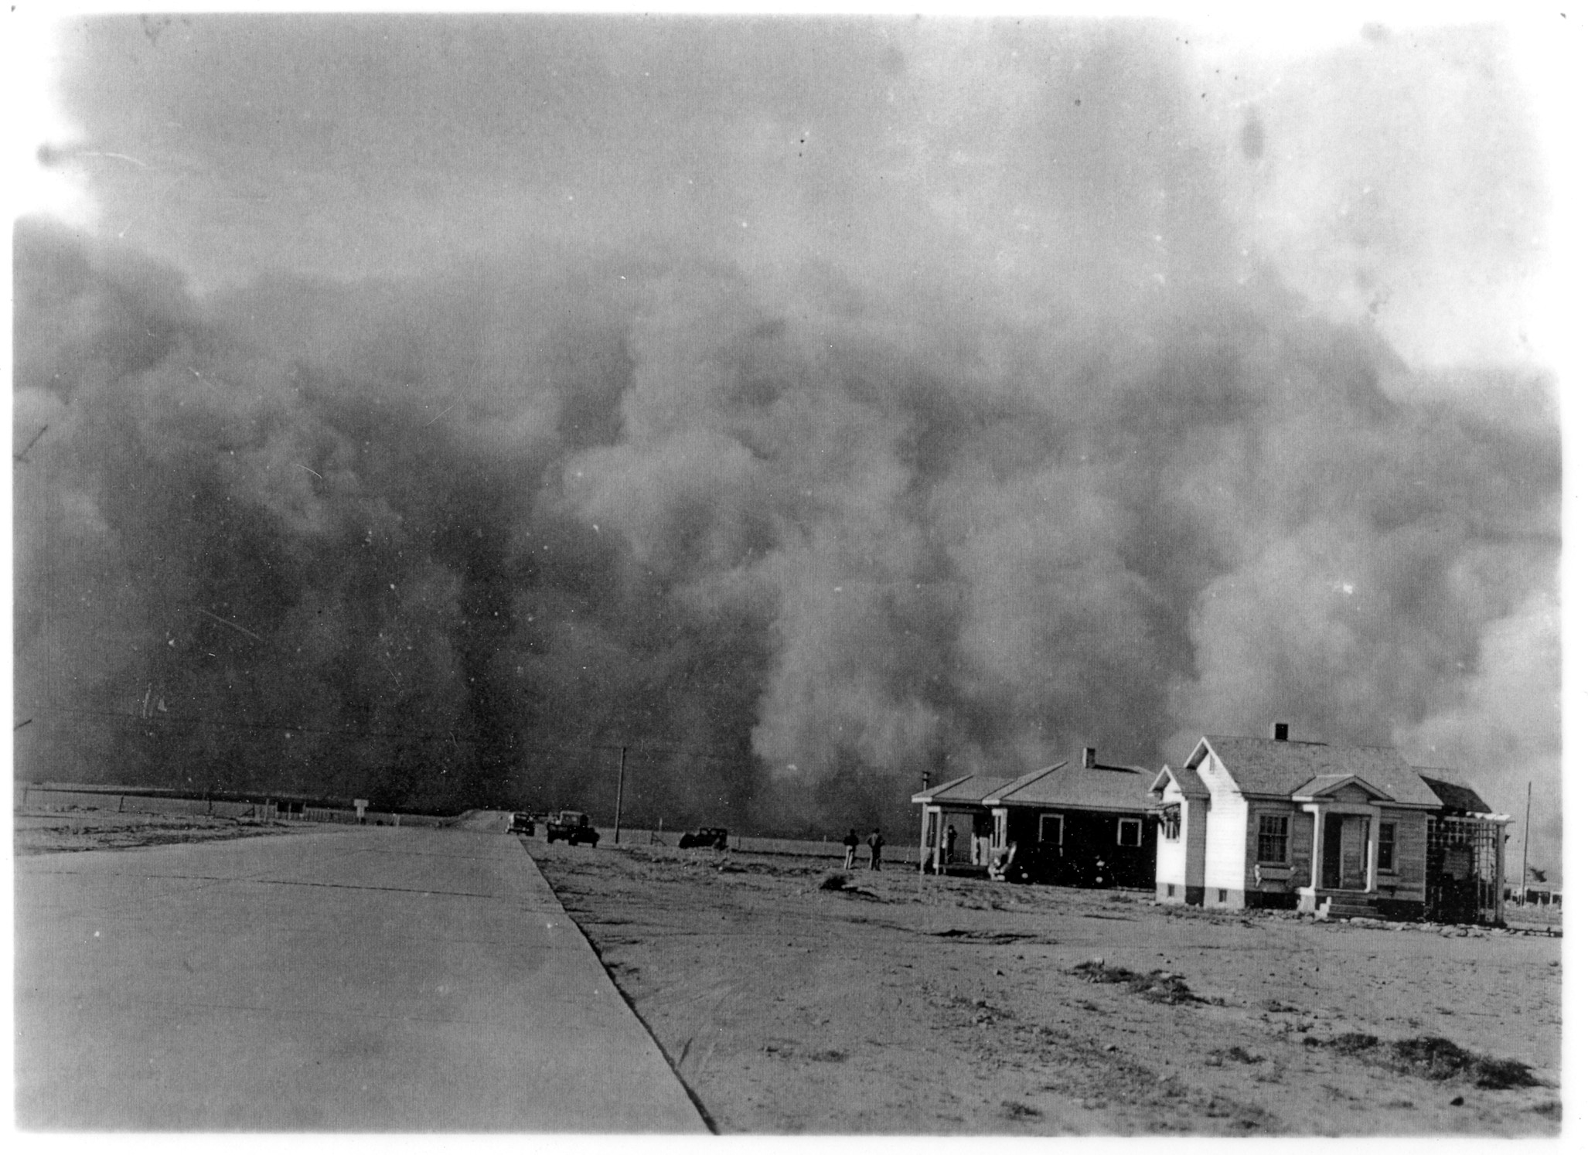

Slide 42
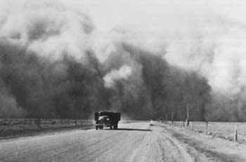

Slide 43
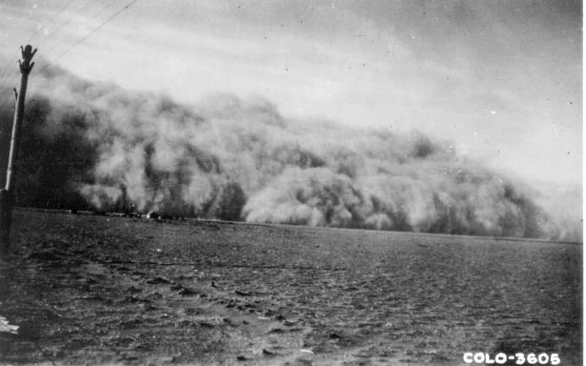

Slide 44
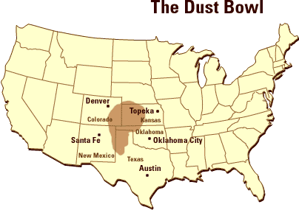

Slide 45
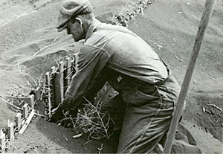
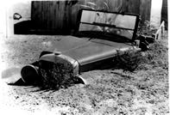
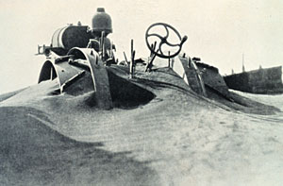
Notes:
The clouds appeared on the horizons with a thunderous roar. Turbulent dust clouds rolled in generally from the North and dumped a fine silt over the land. Men, women and children stayed in their houses and tied handkerchiefs over their noses and mouths. When they dared to leave, they added goggles to protect their eyes. Houses were shut tight, cloth was wedged in the cracks of the doors and windows but still the fine silt forced its way into houses, schools and businesses. During the storms, the air indoors was "swept" with wet gunny sacks. Sponges were used as makeshift "dust masks" and damp sheets were tied over the beds.

Slide 46
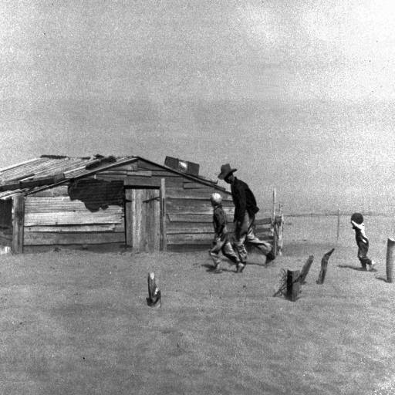
Imagine trying to live in these conditions.
The dust storms lasted from 1931-1939
Notes:
Every possible crack was plugged, sheets were placed over windows and blankets were hung behind doors. Often the places were so tightly plugged against the dust (which still managed to get in) that the houses became extremely hot and stuffy.

Slide 47
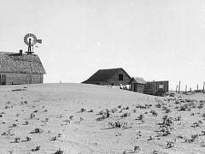
Farmers and their families had to leave
Notes:
Every possible crack was plugged, sheets were placed over windows and blankets were hung behind doors. Often the places were so tightly plugged against the dust (which still managed to get in) that the houses became extremely hot and stuffy.

Slide 48
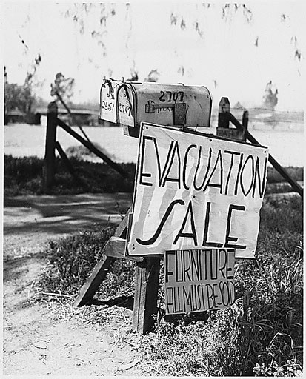
They had to sell everything

Slide 49
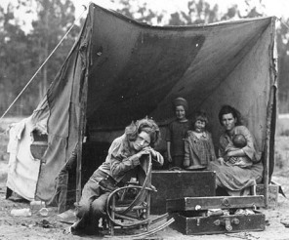
They took to the road. Where would they go?

Slide 50
California had great farmland and no dust.
They would migrate to California

Slide 51
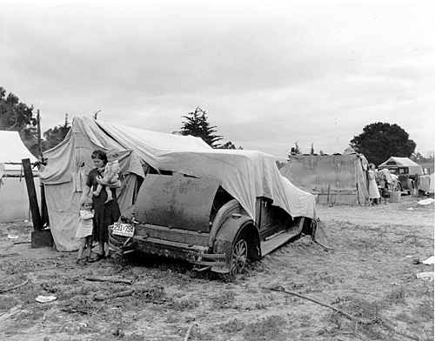
Description : Oklahoma Migrant family looking for work in the pea fields. California. 1935

Slide 52
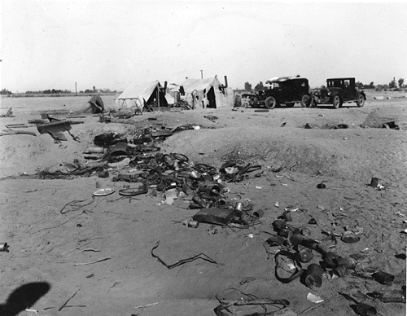
Life was hard in a refugee camp

Slide 53
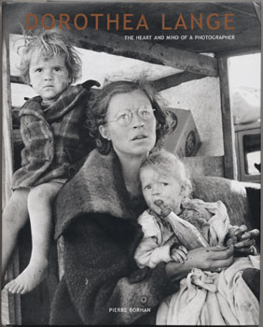
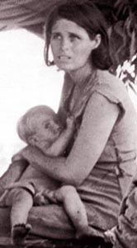
Farming in the Panhandle
Wheat was a real good thing. The world needed it and was paying a good price for it. Wheat farmers with tractors, one way plows and combines purchased by most farmers after the phenomenal crop of 1926, began plowing and planting wheat as never before. The lands were planted to wheat year after year without a thought as to the damage that was being done. Grasslands that should have never been plowed were plowed up. Millions of acres of farm land in the great plains were broken.
1930 was dry but most of the farmers made a wheat crop. In 1931 the wheat crop was considered a bumper crop with over twelve million bushels of wheat. Wheat was everywhere, in the elevators, on the ground and in the road. The wheat supply forced the price down from sixty-eight cents/bushel in July 1930 to twenty-five cents/bushel in July 1931. Many farmers went broke and others abandoned their fields.
With continuing hard times and dry years, the farmers, who still had a lot of pioneering spirit and faith in the land, made ready to weather the storms. The old survival methods of pioneering were brought out of storage, dusted off and put into practice. Many farmers increased their milk cow herd. The cream from the cows was sold and the skim milk was fed to chickens and pigs.
When normal feed crops failed, thistles were harvested, and when thistles failed, hardy souls dug up soap weed which was chopped in a feed mill or by hand and fed to the stock. This was a back breaking, disheartening chore which would have broken weaker people. But to the credit of the residents of the Dust Bowl, they shouldered their task and carried on.
“
Women tried to look after their families while the men looked for work

Slide 54
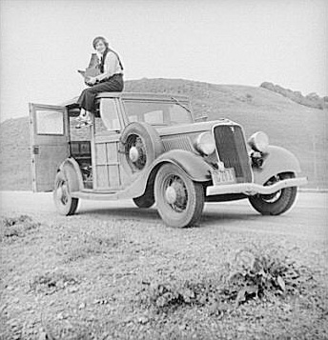
Dorothea Lange: amazing photographer of the migrant family experience. Her photos made a huge impact on America.
Dorothea Lange, Resettlement Administration photographer, in California atop car with her giant camera February 1936.

Slide 55
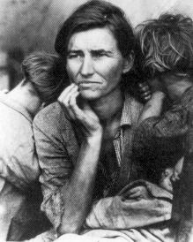
This is her most famous photo

Slide 56
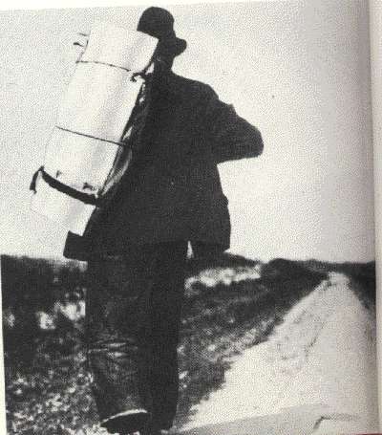
Many farm laborers and ranch hands travelled the roads in search of work in California.

Slide 57
These are the types of characters
Steinbeck writes about

Slide 58
During the time Steinbeck was writing “Of Mice and Men” it was a difficult time for America. It was the time of The Great Depression.

Slide 61
The Salinas River area in California.
Where Steinbeck grew up & worked on ranches.
Into this area came many jobless men
in the 30s.

Slide 62
What we have learnt in this powerpoint
There was a farming crisis due to dust storms and drought
during the 1930s in the middle of America
Many farmers and their families moved to California to find work.
John Steinbeck’s experiences on the land as a ranch hand
In the 30s helped him to create interesting characters.
John Steinbeck wrote Of Mice and Men in the mid 30s
during The Great Depression
John Steinbeck is a very important writer in American literature
Of Mice and Men is banned a lot in American schools because of its language and sexism.

Slide 63
Write down
3 points you thought
Were interesting
or
3 things you didn’t know before

