Slide 1
The novel, A Christmas Carol, shows a "miserly" protagonist Ebeneezer Scrooge visited by three spirits who changed him into a generous man.
Which of the following words or phrases best suggests a meaning associated with the word in quotations?
cheapskate
single and elderly
unhappy
wealthy

Slide 2
Maya's decision to study for the biology exam instead of going to the movie with her friends was "prudent." She got an "A" on the exam while her movie going friends got D's.
2. Which of the following words or phrases defines the word in quotations?
anti-social
wise
selfish
calculating

Slide 3
3. While we were swimming in the creek, time seemed like it didn't exist. But it did, and our curfew hour sneaked past us like a cat in the shadows.
3A). What do these sentences mean?
At the creek, there were many stray cats hiding in the shadows.
The speaker is terrified of cats, especially when he or she is in the dark.
Cats are the stealthiest animals in the entire world, and they are also deadly hunters.
The speaker was having so much fun at the creek that he or she lost track of time.
3B). What literary device is most strongly used in the sentences?
Imagery
Personification
Simile
Metaphor

Slide 4
4. Which of the following sentences contains an allusion?
Randy and his father found an old stamp collection in their attic.
The collection primarily consisted of postage stamps from the early 1900s.
Randy's father studied the writing on the inside of the box.
When Randy asked how old the collection was, his father answered, "Four score and seven years."

Slide 5
5. Read the following passage and then answer the question that follows.
Shrieks of laughter jarred Melanie from her reverie in the hallway. She looked down at the trembling hands in her lap and shook her head. "It's just a party," she told herself, "and nothing to be scared of." Shrill voices mocked and teased, and wild howls of glee once again erupted. Melanie inhaled deeply, stood, and walked slowly toward the birthday party.
What is the author's purpose for writing this passage?
to entertain the reader with a dramatic story about a wild party
to explain how a rowdy party might intimidate some people
to encourage the reader to invite Melanie to parties so she gets over her nerves
to amuse the reader with a funny anecdote about Melanie’s childhood

Slide 6
6. The scientist leaned over the microscope. In just sixty seconds, he knew that the minute, one-celled organisms would begin to divide and grow. He chuckled with happy anticipation as he began to peer into the eyepiece.
What does minute mean in the sentences above?
a unit of time measurement
unable to speak
a type of musical composition
very small in size

Slide 7
7. The neighborhood lost its cultural edge and personality when all the young, wealthy, professionally-driven suburbanites moved in and the neighborhood fell victim to "terminal gentrification."
Choose the option that best defines the word in quotations.
a housing development of varied socio-economic levels that maintains diversity
renovation of bus and train terminals in metropolitan areas
changes made when wealth moves into an area and brings changes to the neighborhood
gentlemanly behaviour prevalent in society

Slide 8
8. The denotation of a word is the literal definition. The connotation of a word refers to associations or emotions attached to the word.
The definition of snake is "any of numerous scaly, legless, sometimes venomous reptiles."
What are connotative examples of snake?
redemptive and saving
angelic and saint like
virtuous and honorable
evil and danger

Slide 9
Obesity is a disease that is facing new generations every day. Younger and younger children are being reported by doctors to U.S. health organizations as being extremely overweight and exercising less. What can be done to curb this current trend? The Secretary of Education is looking for an answer. The government started with school nutrition; most schools no longer offer items such as french fries or sugary sodas. These high carbohydrate foods that are high in calories and low in long term benefits are being traded for salads, lean proteins, fruit juices, and bottled water. The next area to be reformed in public schools is the physical education department. Schools must take responsibility for the physical and mental well being of their students if obesity is to be stopped.
9. What is the main idea of this passage?
Schools need to serve better food.
Students who don't like sports are obese.
Students need to get more exercise the way they did ten years ago.
Schools need to do their part in fighting childhood obesity.

Slide 10
10. Being intolerant of a person for a reason beyond that person's control is a form of prejudice. It is important to remember that everyone is created equal and should be respected.
What is the main idea?
Tolerance from others is deserved by all.
Not being tolerant is acceptable in some situations.
Agreeing with others is how to show tolerance.
To be tolerant is to be open-minded and fair.

Slide 11
11. The denotation of a word is the literal definition. The connotation of a word refers to associations or emotions attached to the word.
The definition of home is "the place where one lives." What are connotative examples of home?
foreign, distant, and far off
family, love, and comfort
contain, hold, and admit
global, transnational, and planetary

Slide 12
12. What is the author’s tone in the below quote?
“I am for doing good to the poor, but I differ in opinion about the means. I think the best way of doing good to the poor is not making them easy in poverty, but leading or driving them out of it.” - Ben Franklin
Compassionate
Judgmental
Insightful
Sarcastic

Slide 13
13. What two tones are expressed in the following dialogue?
“These days, all teenagers are irresponsible and selfish.”
“How CAN you even say that with a straight face??? Teenagers do school work, have jobs, and participate in sports!”
“They might DO those things, but that doesn’t mean they do them well or don’t have ulterior motives---like trying to look good on a resume. They don’t DO them out of the goodness of their character. They have to do them.”
“You must not know many teenagers. My experience shows me teens who are genuinely kind, giving, hard-working, and responsible.”
Sarcastic and irate
Critical and defensive
Judgmental and supportive
Ironic and angry

Slide 14
14. What tone best describes the below quotation?
"Finish every day and be done with it. You have done what you could. Some blunders and absurdities no doubt have crept in; forget them as soon as you can. Tomorrow is a new day; begin it well and serenely and with too high a spirit to be cumbered with your old nonsense. This day is all that is good and fair. It is too dear, with its hopes and invitations, to waste a moment on yesterdays."
~ Ralph Waldo Emerson
Sentimental
Cautionary
Reminiscent
Inspirational

Slide 15
.What is the TONE of the following quote?
“Never in the field of human conflict was so much owed by so many to so few.” - Winston Churchill
Condescending
Gratifying
Patriotic
Reminiscent

Slide 16
What is the image satirizing?
construction zones
fashion
digital overload
the government

Slide 17
The Courage That My Mother Had
The courage that my mother had
Went with her, and is with her still:
Rock from New England quarried;
Now granite in a granite hill.
The golden brooch
my mother wore
She left behind for me to wear;
I have no thing I treasure more:
Yet it is something I could spare.
Oh, if instead she’d left to me
The thing she took into the grave!—
That courage like a rock, which she
Has no more need of, and I have.
Which sentence BEST describes the theme of this poem?
Personal strengths are more important than valuable objects.
Only a daughter can truly relate to her mother’s feelings.
Having a golden brooch is better than nothing.
Unlike jewelry, traits such as courage are not valued.

Slide 18
The Courage That My Mother Had
The courage that my mother had
Went with her, and is with her still:
Rock from New England quarried;
Now granite in a granite hill.
The golden brooch
my mother wore
She left behind for me to wear;
I have no thing I treasure more:
Yet it is something I could spare.
Oh, if instead she’d left to me
The thing she took into the grave!—
That courage like a rock, which she
Has no more need of, and I have.
Which phrase from the poem creates a tone of sadness and regret?
“Rock from New England quarried”
“Oh, if instead she’d left to me”
“The golden brooch my mother wore”
“That courage like a rock”

Slide 19
The Courage That My Mother Had
The courage that my mother had
Went with her, and is with her still:
Rock from New England quarried;
Now granite in a granite hill.
The golden brooch
my mother wore
She left behind for me to wear;
I have no thing I treasure more:
Yet it is something I could spare.
Oh, if instead she’d left to me
The thing she took into the grave!—
That courage like a rock, which she
Has no more need of, and I have.
Which pair of nouns BEST describes the mood of this poem?
admiration and longing
distrust and jealousy
awe and amazement
anger and resentment

Slide 20
Wildflowers
The bellflower’s cup is a five-pointed star,
Translucent and thin
As an onion skin.
The beach rose smells like a citrus fruit—
5 Acrid, yet sweet—
A lemony treat.
The milkweed, in autumn, sends out its seeds,
Traveling the wind’s routes
In downy parachutes.
10 The scarlet nasturtium is striking and bright,
A trailing vine
That loves to climb.
The forget-me-not blossom is blue and gold,
A keepsake of love
15 For those bereft of.
The iris has whorls of purple and white,
And a stubbly beard
That looks quite weird.
The Queen Anne’s lace is noble and prime,
20 A sovereign cloud
Of beauty endowed.
And the florist’s flower is beautiful, too,
But those that grow free
Are special to me.
In Line 19, the phrase noble and prime suggests that the Queen Anne’s lace—
is invaluable.
has a regal beauty to it.
was first grown by an English queen.
is the tallest of all the wildflowers.

Slide 21
Wildflowers
The bellflower’s cup is a five-pointed star,
Translucent and thin
As an onion skin.
The beach rose smells like a citrus fruit—
5 Acrid, yet sweet—
A lemony treat.
The milkweed, in autumn, sends out its seeds,
Traveling the wind’s routes
In downy parachutes.
10 The scarlet nasturtium is striking and bright,
A trailing vine
That loves to climb.
The forget-me-not blossom is blue and gold,
A keepsake of love
15 For those bereft of.
The iris has whorls of purple and white,
And a stubbly beard
That looks quite weird.
The Queen Anne’s lace is noble and prime,
20 A sovereign cloud
Of beauty endowed.
And the florist’s flower is beautiful, too,
But those that grow free
Are special to me.
Which line from the poem is an example of a simile?
The beach rose smells like a citrus fruit—
In downy parachutes.
A keepsake of love
And the florist’s flower is beautiful, too,

Slide 22
Wildflowers
The bellflower’s cup is a five-pointed star,
Translucent and thin
As an onion skin.
The beach rose smells like a citrus fruit—
5 Acrid, yet sweet—
A lemony treat.
The milkweed, in autumn, sends out its seeds,
Traveling the wind’s routes
In downy parachutes.
10 The scarlet nasturtium is striking and bright,
A trailing vine
That loves to climb.
The forget-me-not blossom is blue and gold,
A keepsake of love
15 For those bereft of.
The iris has whorls of purple and white,
And a stubbly beard
That looks quite weird.
The Queen Anne’s lace is noble and prime,
20 A sovereign cloud
Of beauty endowed.
And the florist’s flower is beautiful, too,
But those that grow free
Are special to me.
How does the mood the poet creates relate to the purpose of the poem?
The mood is nostalgic because the poet is remembering these flowers from when he was a child.
The mood is envious because the poet wishes that he could be free like the wildflowers.
The mood is yearning because the poet wishes that wildflowers were as popular as florist’s flowers.
The mood is appreciative because the poet enjoys many characteristics of the wildflowers.

Slide 23
Wildflowers
The bellflower’s cup is a five-pointed star,
Translucent and thin
As an onion skin.
The beach rose smells like a citrus fruit—
5 Acrid, yet sweet—
A lemony treat.
The milkweed, in autumn, sends out its seeds,
Traveling the wind’s routes
In downy parachutes.
10 The scarlet nasturtium is striking and bright,
A trailing vine
That loves to climb.
The forget-me-not blossom is blue and gold,
A keepsake of love
15 For those bereft of.
The iris has whorls of purple and white,
And a stubbly beard
That looks quite weird.
The Queen Anne’s lace is noble and prime,
20 A sovereign cloud
Of beauty endowed.
And the florist’s flower is beautiful, too,
But those that grow free
Are special to me.
The theme of this poem deals with which of the following topics?
the wonders of our planet
the mysteries of the universe
the beauty of nature
the endurance of natural things

Slide 24
Wildflowers
The bellflower’s cup is a five-pointed star,
Translucent and thin
As an onion skin.
The beach rose smells like a citrus fruit—
5 Acrid, yet sweet—
A lemony treat.
The milkweed, in autumn, sends out its seeds,
Traveling the wind’s routes
In downy parachutes.
10 The scarlet nasturtium is striking and bright,
A trailing vine
That loves to climb.
The forget-me-not blossom is blue and gold,
A keepsake of love
15 For those bereft of.
The iris has whorls of purple and white,
And a stubbly beard
That looks quite weird.
The Queen Anne’s lace is noble and prime,
20 A sovereign cloud
Of beauty endowed.
And the florist’s flower is beautiful, too,
But those that grow free
Are special to me.
After reading this poem, what can the reader infer about the poet?
The poet has a garden filled with wildflowers.
The poet knows about the varieties of wildflowers.
The poet’s favorite wildflower is Queen Anne’s lace.
The poet’s home is surrounded by nasturtiums.

Slide 25
Wild Geese, by Mary Oliver
You do not have to be good. You do not have to walk on your knees For a hundred miles through the desert, repenting. You only have to let the soft animal of your body love what it loves. Tell me about your despair, yours, and I will tell you mine. Meanwhile the world goes on. Meanwhile the sun and the clear pebbles of the rain are moving across the landscapes, over the prairies and the deep trees, the mountains and the rivers. Meanwhile the wild geese, high in the clean blue air, are heading home again. Whoever you are, no matter how lonely, the world offers itself to your imagination, calls to you like the wild geese, harsh and exciting -- over and over announcing your place in the family of things.
Read these lines from the poem.
You do not have to walk on your knees
for a hundred miles through the desert, repenting.
Meanwhile the wild geese, high in the clean blue air, are heading home again.
By juxtaposing the two images contained in these lines, the poem suggests that —
geese possess a beauty and strength that people lack
like most animals, people are controlled by instinct
the natural world is free of guilt and accusation
animals are able to choose their own path

Slide 26
Wild Geese, by Mary Oliver
You do not have to be good. You do not have to walk on your knees For a hundred miles through the desert, repenting. You only have to let the soft animal of your body love what it loves. Tell me about your despair, yours, and I will tell you mine. Meanwhile the world goes on. Meanwhile the sun and the clear pebbles of the rain are moving across the landscapes, over the prairies and the deep trees, the mountains and the rivers. Meanwhile the wild geese, high in the clean blue air, are heading home again. Whoever you are, no matter how lonely, the world offers itself to your imagination, calls to you like the wild geese, harsh and exciting -- over and over announcing your place in the family of things.
Which of these lines provides the best evidence that the poem promotes gaining self-awareness through intuition?
You only have to let the soft animal of your body/love what it loves.
Meanwhile the wild geese, high in the clean blue air,/are heading home again.
Meanwhile the sun and the clear pebbles of the rain/are moving across the landscapes,
You do not have to walk on your knees/for a hundred miles through the desert, repenting.

Slide 27
Wild Geese, by Mary Oliver
You do not have to be good. You do not have to walk on your knees For a hundred miles through the desert, repenting. You only have to let the soft animal of your body love what it loves. Tell me about your despair, yours, and I will tell you mine. Meanwhile the world goes on. Meanwhile the sun and the clear pebbles of the rain are moving across the landscapes, over the prairies and the deep trees, the mountains and the rivers. Meanwhile the wild geese, high in the clean blue air, are heading home again. Whoever you are, no matter how lonely, the world offers itself to your imagination, calls to you like the wild geese, harsh and exciting -- over and over announcing your place in the family of things.
Read these lines from the poem.
Tell me about despair, yours, and I will tell you mine.
Meanwhile the world goes on.
These lines suggest —
the futility of talk
the need for forgiveness
the desire for change
the uselessness of hope

Slide 28
Wild Geese, by Mary Oliver
You do not have to be good. You do not have to walk on your knees For a hundred miles through the desert, repenting. You only have to let the soft animal of your body love what it loves. Tell me about your despair, yours, and I will tell you mine. Meanwhile the world goes on. Meanwhile the sun and the clear pebbles of the rain are moving across the landscapes, over the prairies and the deep trees, the mountains and the rivers. Meanwhile the wild geese, high in the clean blue air, are heading home again. Whoever you are, no matter how lonely, the world offers itself to your imagination, calls to you like the wild geese, harsh and exciting -- over and over announcing your place in the family of things.
By beginning lines 1, 2, and 4 with “You” and then beginning lines 7, 8, and 12 with
“Meanwhile,” the poet emphasizes —
the moral imperative for each person to take responsibility for protecting the natural world
the contrast between the misery of a person lost in despair and the magnificence of the natural world
the parallel between the changing phases in a person’s life and the eternal cycles found in nature
the need for each person to understand the geographic features of his or her natural environment

Slide 29
Wild Geese, by Mary Oliver
You do not have to be good. You do not have to walk on your knees For a hundred miles through the desert, repenting. You only have to let the soft animal of your body love what it loves. Tell me about your despair, yours, and I will tell you mine. Meanwhile the world goes on. Meanwhile the sun and the clear pebbles of the rain are moving across the landscapes, over the prairies and the deep trees, the mountains and the rivers. Meanwhile the wild geese, high in the clean blue air, are heading home again. Whoever you are, no matter how lonely, the world offers itself to your imagination, calls to you like the wild geese, harsh and exciting -- over and over announcing your place in the family of things.
Read these lines from the poem.
Meanwhile the sun and the clear pebbles of the rain
are moving across the landscapes,
over the prairies and the deep trees,
the mountains and the rivers.
Meanwhile the wild geese, high in the clean blue air,
are heading home again.
The tone of this section of the poem can best be described as —
uplifting
straightforward
conversational
condescending

Slide 30
Wild Geese, by Mary Oliver
You do not have to be good. You do not have to walk on your knees For a hundred miles through the desert, repenting. You only have to let the soft animal of your body love what it loves. Tell me about your despair, yours, and I will tell you mine. Meanwhile the world goes on. Meanwhile the sun and the clear pebbles of the rain are moving across the landscapes, over the prairies and the deep trees, the mountains and the rivers. Meanwhile the wild geese, high in the clean blue air, are heading home again. Whoever you are, no matter how lonely, the world offers itself to your imagination, calls to you like the wild geese, harsh and exciting -- over and over announcing your place in the family of things.
Read these lines from the poem.
Whoever you are, no matter how lonely,
the world offers itself to your imagination,
calls to you like the wild geese, harsh and exciting—
over and over announcing your place
in the family of things.
These lines suggest that the poet’s purpose for writing the poem is to persuade the reader
to —
re-examine old assumptions about human nature compared with the nature of wild animals
appreciate how natural forces work in nature
develop an understanding of the role people play in the natural world
overcome alienation by creating a new relationship with the natural world

Slide 31
Read the following excerpt from Andy Weir's novel The Martian. The protagonist has been stranded on Mars and has been keep a log of his thoughts and actions while stuck there. This excerpt begins with NASA officials trying to figure out how to get him home and end with one of the protagonist's log entries. "Any idea on how to keep him alive for four years?" "Nope." "Work on that, too." "Will do," Venkat said. Teddy swiveled his chair and looked out the window to the sky beyond. Night was edging in. "What must it be like?" he pondered. "He's stuck out there. He thinks he's totally alone and that we all gave up on him. What kind of effect does that have on a man's psychology?" He turned back to Venkat. "I wonder what he's thinking right now." LOG ENTRY: SOL 61 How come Aquaman can control whales? They're mammals! Makes no sense. What literary device is being used for humorous effect? a. juxtaposition b. allusion c. pun d. rhetorical device

Slide 32
Read the following passage from "Polar Night" by Norah Burke. The story is about a female polar bear who is getting ready for winter. At this point in the story, she has just killed a seal and heard a noise. She hid and this is what happens next: Presently she saw upright seals coming along the shore. They were rather rare creatures, these, and dangerous for all they were so weak. The places they lived had light and noise, and smelled of good food. The she-bear often drew near the places, attracted by those smells. She hunted these land-seals too, and ate them when she could. They were not like the sea-seals, though. They wore seal fur, and their skins were rubbed with seal blubber, but there was a different taste inside. Based on this passage, the term "land-seal" probably means: a. sea lions b. leopard seals c. some unknown animals d. humans

Slide 33
Read this passage from The Running Man by Richard Bachman: "Oh dear God," Amelia Williams moaned.
Richards looked down at himself casually. His entire right side, from ribcage to calf, was bright and sparkling red.
"Who would have thought the old man had so much blood in him?" Richards said.
What literary term is the last line said by Richards?
a. allusion
b. cliche
c. personification
d. metaphor

Slide 34
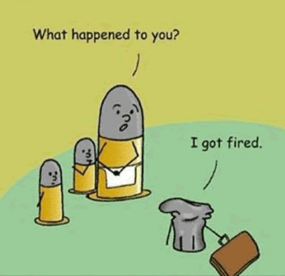
This is an example of which literary term?
a. pun
b. situational irony
c. metaphor
d. alliteration

Slide 35
Look at the picture :
Using the headline,
what is this an example of?
a. satire
b. irony
c. rhetorical device
d. idiom

Slide 36
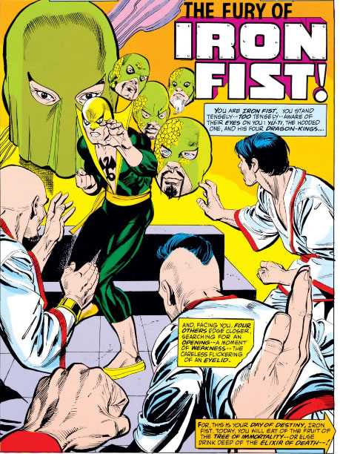
Look at this panel from the first appearance
of Marvel's Iron Fist:
What is the purpose of writing these
captions in 2nd person point of view?
to mimic Asian writing styles
b. to make the reader feel like he
or she is the main character
c. second person is the traditional
style used to write comics
d. the point of view is awkward, so
it shows that Iron Fist will be a
fallen hero or villain as the series
progresses.

Slide 37
What two literary terms drive the
humor in this image? a. verbal irony and periphrasis b. alliteration and dramatic irony c. allusion and pun d. archetypes and imagery

Slide 38
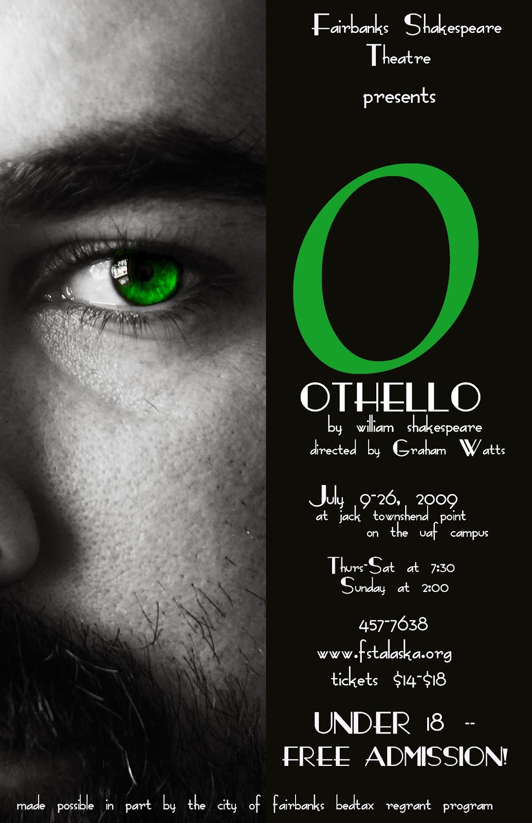
Based in the poster, one
of the themes of Othello is:
a. jealousy
b. hatred
c. fidelity
d. love

Slide 39
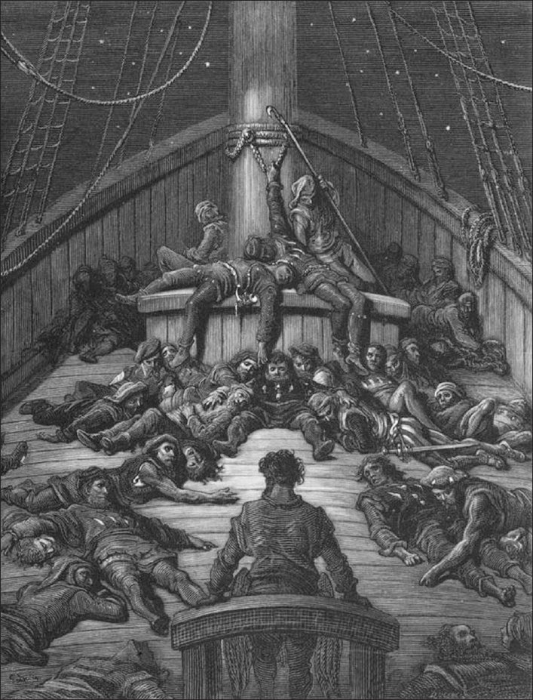
"Rime of the Ancient Mariner" by Coleridge is an excellent poem about some freaky things that happen to this guy while on a boat on the ocean. Read the following excerpt: “Water, water, everywhere, And all the boards did shrink; Water, water, everywhere, Nor any drop to drink.” What is the above an example of?
a. hyperbole
b. imagery
c. situational irony
d. unreliable narrator

Slide 40
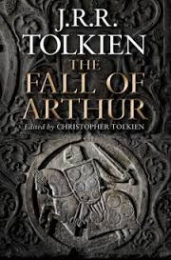
Read the following from J. R. R. Tolkien's work, The Fall of Arthur: Greatest was Gawain, whose glory waxed as times darkened, true and dauntless, among knights peerless ever anew proven, defence and fortress of a falling world What word could replace "waxed" in the second line? a. faded b. increased c. faltered d. fearless

Slide 41
Read the following excerpt from Fahrenheit 451. This is a book written in the 1950s that takes place in our future. The little mosquito-delicate dancing hum in the air, the electrical murmur of a hidden wasp snug in its special pink warm nest. The music was almost loud enough so he could follow the tune. Without turning on the light he imagined how this room would look. His wife stretched on the bed, uncovered and cold, like a body displayed on the lid of the tomb, her eyes fixed in the ceiling by invisible threads of steel, immovable. And in her ears the little Seashells, the thimble radios tamped tight, and an electronic ocean of sound, of music and talk and music and talk coming in, coming in on the shore of her unsleeping mind. The room was indeed empty. Every night the waves came in and bore her off on their great tides of sound, floating her, wide-eyed, toward morning. There had been no night in the last two years that Mildred had not swum that sea, had not gladly gone down in it for the third time. What is the purpose of the metaphor in this passage? a. to explain how Mildred drowned b. to show that Mildred cannot swim c. to explain how Mildred listens to music d. to show Mildred's unique fashion sense

