Slide 1
He Had It Coming
Read this short story by Richard Brautigan: "It is hard to live in a studio apartment in San Jose with a man who's learning to play the violin." That's what she told the police when she handed them the empty revolver.
Based on this story, what is most likely to happen next? a. the police will arrest the man for disturbance of the peace b. the police will suggest an apartment for her to move to
c. the woman will go to jail
d. the police will fine the man for playing too loudly

Slide 2
The Stars and Stripes
Read the first stanza from "The Star Spangled Banner." Oh, say, can you see, by the dawn's early light, What so proudly we hailed at the twilight's last gleaming? Whose broad stripes and bright stars, thru the perilous fight, O'er the ramparts we watched, were so gallantly streaming? And the rockets' red glare, the bombs bursting in air, Gave proof through the night that our flag was still there. O say, does that star-spangled banner yet wave O'er the land of the free and the home of the brave? According to this stanza, where is the flag? a. flying proudly over the fort b. flying proudly over the land of the free and the home of the brave c. destroyed by a bomb that burst in mid air d. the author doesn't know for sure if the flag is still flying

Slide 3
Read the following excerpt from “The Bet” by Anton Chekhov:
“The banker thought it strange that someone who had mastered six-hundred abstruse tomes in four years should spend nearly a year reading one slim, easily comprehensible volume.” (tomes- large, scholarly, or ponderous books) Which word could replace abstruse in the passage? A. Simple B. Complicated C. Crazy D. Agonizing

Slide 4
Nothing Good Happens after 11:00 Anyway
I was late coming home and missed my curfew only by about 30 minutes or so. My mother was so angry. She had stayed up to wait for me to come home. When I got in, she didn't ask if I was O.K. or if there was a wreck. Instead she yelled, "I've told you a million times not to be late!" I guess she was worried about me, but I still hate being yelled at. What is the purpose of the hyperbole in the above statement? a. to set the scene and introduce the characters b. to make the point that the narrator should have known better c. to contrast between the irritation of the narrator and the exasperation of the mother d. to provide an ironic twist to the story

Slide 5
Determine the meaning of the bold-faced word based on how it is used in the sentence. On your paper, write a short definition in the first column, and then write the clue(s) that most helped you in the second column.
Ms. Witherspoon was shocked that the snickering bill collector was brazen enough to rest his feet on the antique grand piano, with his shoes on of all things, while she ran to get her checkbook.
happy
determined
comfortable
bold

Slide 6
Those Winter Sundays
by Robert Hayden
Sundays too my father got up early
and put his clothes on in the blueblack cold,
then with cracked hands that ached
from labor in the weekday weather made
5 banked fires blaze. No one ever thanked him.
I’d wake and hear the cold splintering, breaking.
When the rooms were warm, he’d call,
and slowly I would rise and dress,
fearing the chronic angers of that house.
10 Speaking indifferently to him,
who had driven out the cold
and polished my good shoes as well.
What did I know, what did I know
of love’s austere and lonely offices?
Why is the multiple meaning of the word offices in line 14 important to the poem?
A. It refers to both a duty and a service done for others.
B. It conveys the father’s mixed emotions.
C. It refers to both a place and an executive position.
D. It indicates the size of the speaker’s house.

Slide 7
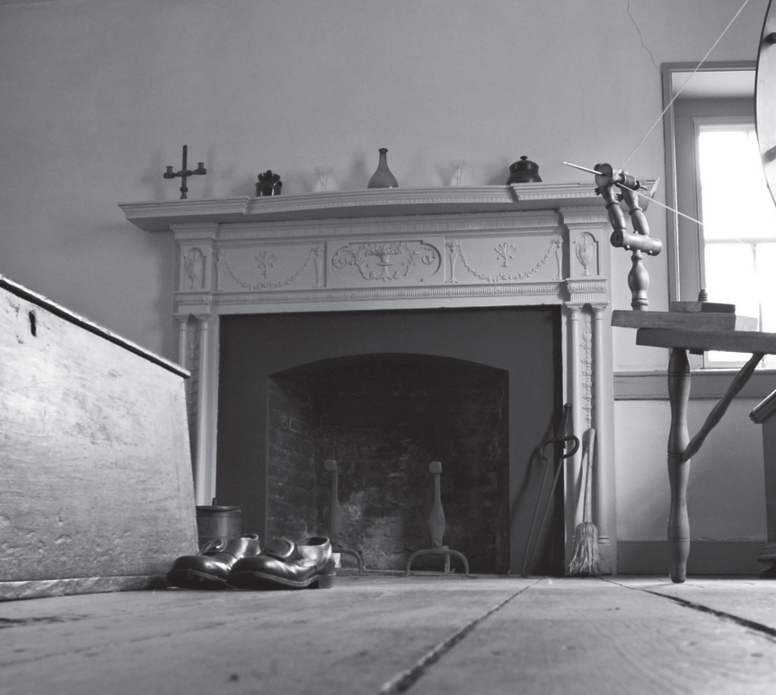
Those Winter Sundays
by Robert Hayden
Sundays too my father got up early
and put his clothes on in the blueblack cold,
then with cracked hands that ached
from labor in the weekday weather made
5 banked fires blaze. No one ever thanked him.
I’d wake and hear the cold splintering, breaking.
When the rooms were warm, he’d call,
and slowly I would rise and dress,
fearing the chronic angers of that house.
10 Speaking indifferently to him,
who had driven out the cold
and polished my good shoes as well.
What did I know, what did I know
of love’s austere and lonely offices?
The photograph reinforces the poem’s tone of —
A. indifference
B. desperation
C. melancholy
D. whimsy

Slide 8
Those Winter Sundays
by Robert Hayden
Sundays too my father got up early
and put his clothes on in the blueblack cold,
then with cracked hands that ached
from labor in the weekday weather made
5 banked fires blaze. No one ever thanked him.
I’d wake and hear the cold splintering, breaking.
When the rooms were warm, he’d call,
and slowly I would rise and dress,
fearing the chronic angers of that house.
10 Speaking indifferently to him,
who had driven out the cold
and polished my good shoes as well.
What did I know, what did I know
of love’s austere and lonely offices?
In line 5, the sentence “No one ever thanked him” suggests the poem explores the theme
of —
A. uninformed judgment
B. domestic strife
C. suppressed excitement
D. belated gratitude

Slide 9
Those Winter Sundays
by Robert Hayden
Sundays too my father got up early
and put his clothes on in the blueblack cold,
then with cracked hands that ached
from labor in the weekday weather made
5 banked fires blaze. No one ever thanked him.
I’d wake and hear the cold splintering, breaking.
When the rooms were warm, he’d call,
and slowly I would rise and dress,
fearing the chronic angers of that house.
10 Speaking indifferently to him,
who had driven out the cold
and polished my good shoes as well.
What did I know, what did I know
of love’s austere and lonely offices?
The poem’s setting is significant because it helps contrast —
A. the family’s physical closeness and emotional distance
B. the opinions of the hardworking father and the lazy child
C. the presence of the father and the absence of the mother
D. the different values of the siblings within the family

Slide 10
Those Winter Sundays
by Robert Hayden
Sundays too my father got up early
and put his clothes on in the blueblack cold,
then with cracked hands that ached
from labor in the weekday weather made
5 banked fires blaze. No one ever thanked him.
I’d wake and hear the cold splintering, breaking.
When the rooms were warm, he’d call,
and slowly I would rise and dress,
fearing the chronic angers of that house.
10 Speaking indifferently to him,
who had driven out the cold
and polished my good shoes as well.
What did I know, what did I know
of love’s austere and lonely offices?
The tone of this poem can best be described as —
A. carefree
B. optimistic
C. self-righteous
D. regretful

Slide 11
Those Winter Sundays
by Robert Hayden
Sundays too my father got up early
and put his clothes on in the blueblack cold,
then with cracked hands that ached
from labor in the weekday weather made
5 banked fires blaze. No one ever thanked him.
I’d wake and hear the cold splintering, breaking.
When the rooms were warm, he’d call,
and slowly I would rise and dress,
fearing the chronic angers of that house.
10 Speaking indifferently to him,
who had driven out the cold
and polished my good shoes as well.
What did I know, what did I know
of love’s austere and lonely offices?
The author begins a new stanza in line 6 most likely to indicate a shift from —
A. the distant past to the immediate future
B. literal language to figurative language
C. a focus on the father to a focus on the speaker
D. an uncritical attitude to a self-critical attitude

Slide 12
Read this excerpt from Cry, the Beloved Country by Alan Paton “There is a lovely road that runs from Ixopo into the hills. These hills are grass-covered and rolling, and they are lovely beyond any singing of it. The road climbs seven miles into them, to Carisbrooke; and from there, if there is no mist, you look down on one of the fairest valleys of Africa.” What literary device is being utilized in this passage? A. Pun B. Allusion C. Foreshadowing D. Imagery

Slide 13
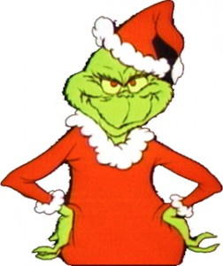
Read the following passage taken from How the Grinch Stole Christmas by Dr. Seuss: Then he growled, with his Grinch fingers nervously drumming, "I MUST find a way to keep Christmas from coming!" For, tomorrow, he knew... ...All the Who girls and boys Would wake up bright and early. They'd rush for their toys! And then! Oh, the noise! Oh, the noise! Noise! Noise! Noise! That's one thing he hated! The NOISE! NOISE! NOISE! NOISE! What is the main purpose for the repetition of the word "noise"? a. it rhymes with toys b. for the rhythm and meter of the poem c. to show how annoying the Whos are with their noise d. for its alliterative properties

Slide 14
The Crow and the Pitcher
A CROW perishing with thirst saw a pitcher, and hoping to find water, flew to it with delight. When he reached it, he discovered to his grief that it contained so little water that he could not possibly get at it. He tried everything he could think of to reach the water, but all his efforts were in vain. At last he collected as many stones as he could carry and dropped them one by one with his beak into the pitcher, until he brought the water within his reach and thus saved his life.
What is the theme in the passage above?
a. Persistence is a value that separates those who survive from those who perish.
b. Perfection is not a possible trait.
c. Someone can provide others with the tools to succeed, but cannot force people to use them.
d. Physical activity will benefit people when they least expect it.

Slide 15
The Mule in the Lion’s Skin
A Mule once found a Lion’s skin which the hunters had left out in the sun to dry. He put it on and went towards his native village. All fled at his approach, both men and animals, and he was a proud Mule that day. In his delight he lifted up his voice and brayed, but then every one knew him, and his owner came up and gave him a sound beating for the fright he had caused. Shortly afterwards, a Fox came up to him and said: “Ah, I knew you by your voice.”
What is the theme in the passage above?
a. Appearances can be misleading and create a false impression.
b. It is better to be called a fool quietly than to open your mouth and confirm suspicions.
c. People who are boastful end up losing what it is they boast about.
d. It is better to always be thankful for what you have, then to wish you had more.

Slide 16
Determine the meaning of the bold-faced word based on how it is used in the sentence.
On your paper, write a ONE WORD REPLACEMENT/SYNONYM in the first column, and then write the clue(s) that most helped you in the second column.
Ronald hated the detention room because it was absolutely devoid of warmth and cheer.

Slide 17
Determine the meaning of the bold-faced word based on how it is used in the sentence.
On your paper, write a ONE WORD REPLACEMENT/SYNONYM in the first column, and then write the clue(s) that most helped you in the second column.
After barely surviving a deadly encounter, Kyle gazed up at the firmament and thanked the heavens that he survived.

Slide 18
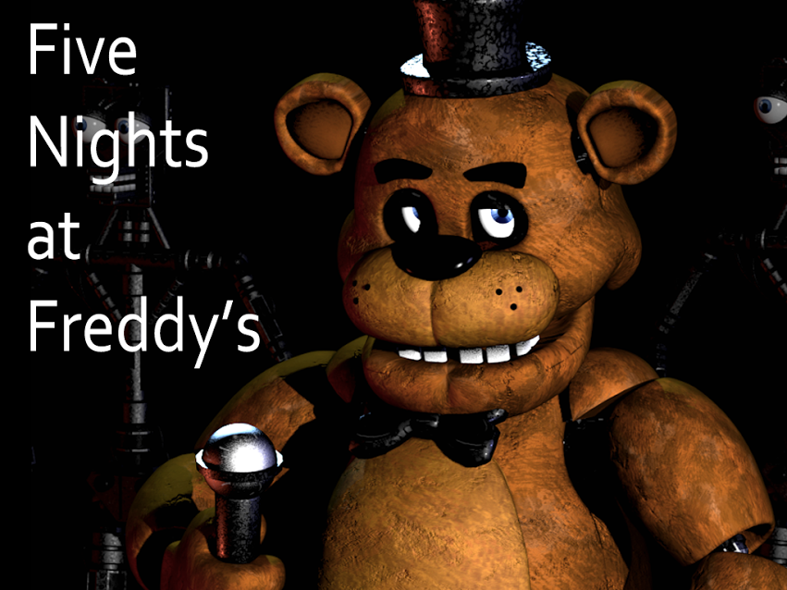
Read this excerpt from Five Nights at Freddy's: Silver Eyes:
"They had written all the time as kids, especially Marla, who wrote like she talked: fast and incoherent. But as they got older they had grown apart, the letters had gotten fewer and further between, the conversations leading up to this trip had been perfunctory and full of awkward pauses."
Using context clues, which pair of words best describes word "perfunctory"?
A: quick/obligatory
B: long/endured
C: careful/considerate
D: detailed/interesting

Slide 19
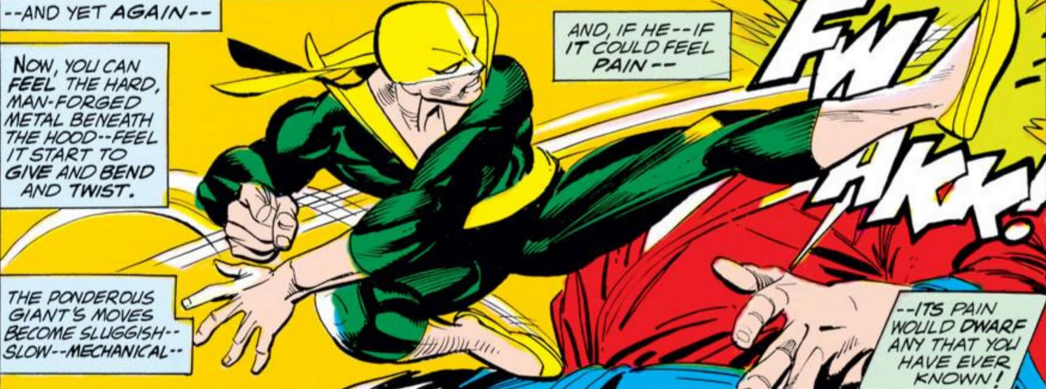
Read this panel from a comic featuring THE IMMORTAL IRON FIST:
Based on how it is used, what is the meaning of PONDEROUS?
a. dwarfish b. slow c. angry d. heavy

Slide 20
Carrying around the compact tablet was much easier than lugging around a heavy laptop.
Based on context clues provided in the passage, which words best describe the meaning of the word compact?
a. spacious/ample room
b. decorous/detailed design
c. tight/neatly packed
d. abundant/plentiful

Slide 21
“Wall Street has turned the economy into a giant asset-stripping scheme, one whose purpose is to suck the last bits of meat from the carcass of the middle class.” - Matt Taibi
“Don't blame Wall Street, don't blame the big banks. If you don't have a job and you are not rich, blame yourself!” - Herman Cain
What literary term and purpose do the words, "Wall Street" serve in these quotes?
a. imagery - to give an image of the actual street and buildings in New York
b. personification – crediting Wall Street with purposeful actions, saying it “has turned,” has “purpose,” can be “blamed”----all things normally attributed to a person
c. metaphor - to represent the powerful and wealthy
d. apostrophe - since the street cannot talk back.
*an apostrophe is a figure of speech in which the speaker addresses an absent person, an abstract idea, or a thing.

Slide 22
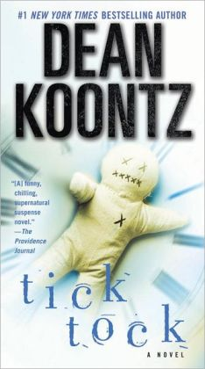
Read the following passage from Dean Koontz's Tick Tock:
"A whirl of dead melalenca leaves like hundreds of tiny knives spun over him, whispering and buzzing against one another..."
In this sentence, what two literary devices does the author use?
a. simile and personification
b. simile and metaphor
c. irony and internal conflict
d. symbolism and indirect characterization

Slide 23
Look at the advertisement:
What is the most likely reason that the company chose to name their cleaning product Ajax?
a. Words that begin with "A" come first alphabetically
b. The last name of the creator is "Ajax"
c. Their cleaner is strong, just like the Greek mythology hero Ajax (who many people might know, based on mythology)
d. It had not been used before, so the company decided to paten it.

Slide 24
Read the following passage from All Quiet on the Western Front:
"We are forlorn like children, and experienced like old men, we are crude and sorrowful and superficial- I believe we are lost."
What theme is being represented in this passage?
a) comradeship
b) dehumanization
c) loss of innocence
d) oneness of man

Slide 25
The Oxen and the Axle-Trees
A HEAVY WAGON was being dragged along a country lane by a team of Oxen. The wheels groaned and creaked terribly; whereupon the Oxen, turning round, thus addressed the wheels: “Hello there! Why do you make so much noise? We bear all the labor, and we, not you, ought to cry out.”
What is the theme in the passage above?
a. The squeaky wheel gets the oil.
b. Work now and play later..
c. Those who do the least work complain the most.
d. Do not attempt too much at once.

Slide 26
Read the following and decide on the tone of the writer:
The coach yelled at us for losing the game. I didn't see what the big deal was. It's not like we're professional athletes or anything. Besides, my mom is taking me to Bojangles after the game whether we win or lose.
What is the tone of this passage:
a. angry
b. ecstatic
c. indifferent
d. sarcastic

Slide 27
The Monkey and the Snake
One winter a Monkey found a Snake stiff and frozen with cold. He had compassion on it, and taking it up, placed it in his bosom. The Snake was quickly revived by the warmth, and resuming its natural instincts, bit the monkey, inflicting on him a mortal wound.
What is the theme in the passage above?
a. Think things through before taking action. Don't be impulsive.
b. A bird in the hand is worth two in the bush.
c. You cannot always change someone's nature by helping him.
d. It is better to be true to yourself than to be popular.

Slide 28
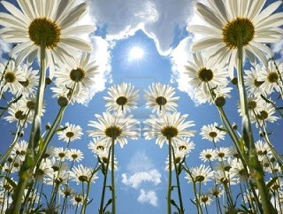
Look at the statement below:
The sun kissed the flowers
Before the clouds closed their eyes.
This is an example of:
a. personification
b. allusion
c. hyperbole
d. irony

Slide 29
Read the following passage:
Who is smarter, males or females? Well if you go by the North Carolina English II EOC scores then the answer is clear. Year after year the scores pile up and more 4s are achieved by . . .
What is the purpose of the first sentence?
a. to set the mood of the passage
b. to set the tone of the passage
c. to give the setting
d. to interest the reader

Slide 30
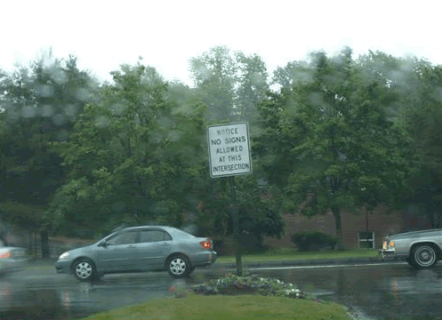
What literary term is this an example of?
The sign says,
“NOTICE – NO SIGNS ALLOWED
AT THIS INTERSECTION”
a. pun
b. hyperbole
c. irony
d. allusion

Slide 31
In A Christmas Carol by Charles Dickens, Ebeneezer Scrooge sees the ghost of Jacob Marely. He refuses to believe that he is seeing a ghost. He explains it by saying:
"You may be an undigested bit of beef, a blot of mustard, a crumb of cheese, a fragment of underdone potato. There's more of gravy than of grave about you, whatever you are!"
The words in bold face and black type are an example of:
a. Situational Irony
b. Allusion
c. Metaphor
d. Pun

Slide 32
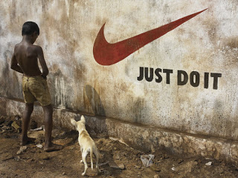
What is the picture below an example of?
(Teachers please forgive me.)
a. archetypes
b. soliloquy
c. hyperbole
d. irony

Slide 33
Read the following quote:
“Hatred is a leech: The thing that sticks to a person's skin; that feeds off them and drains the sap out of one's spirit. It changes a person, and does not leave until it has sucked the last drop of peace from them.”
― Chigozie Obioma, The Fishermen
What literary device is MOST STRONGLY used in this quote to strengthen the author’s purpose?
A) Personification
B) Irony
C) Hyperbole
D) Euphemism

Slide 34
Determine the meaning of the bold-faced word based on how it is used in the sentence.
On your paper, write a ONE WORD REPLACEMENT/SYNONYM in the first column, and then write the clue(s) that most helped you in the second column.
You must not be indiscriminate when you are shopping for shoes. Carefully consider which shoes will be best for you before making you purchase.

Slide 35
Determine the meaning of the bold-faced word based on how it is used in the sentence.
On your paper, write a ONE WORD REPLACEMENT/SYNONYM in the first column, and then write the clue(s) that most helped you in the second column.
Julia had a difficult time trudging up the snowy hill with her textbook laden book bag.

Slide 36
Determine the meaning of the bold-faced words based on how it is used in the sentence.
On your paper, write a ONE WORD REPLACEMENT/SYNONYM for EACH of the bold-faced words in the first column, and then write the clue(s) that most helped you in the second column.
*TWO words in this sentence to define*
This magical sword is called Everest-Tooth because it was forged on the mountain from which its name is derived.

Slide 37
Determine the meaning of the bold-faced word based on how it is used in the sentence.
On your paper, write a ONE WORD REPLACEMENT/SYNONYM in the first column, and then write the clue(s) that most helped you in the second column.
He wanted to climb the lofty coconut tree to retrieve the nourishing fruit, but he was too afraid of heights.

Slide 38
Determine the meaning of the bold-faced word based on how it is used in the sentence.
On your paper, write a ONE WORD REPLACEMENT/SYNONYM in the first column, and then write the clue(s) that most helped you in the second column.
John tried to catch his breath for a minute before he attempted the arduous climb up the peak of the mountain.

Slide 39
Determine the meaning of the bold-faced word based on how it is used in the sentence.
On your paper, write a ONE WORD REPLACEMENT/SYNONYM in the first column, and then write the clue(s) that most helped you in the second column.
Though Kathy and I are both technically store clerks, Kathy is always trying to tell me what to do because of her imperious nature.

Slide 40
In the book, Lord of the Flies, a plane crashes, stranding several young boys on an island with no adults. Early in the book, we meet Ralph, a kid with golden tan skin and blond hair and Piggy, a fat boy with glasses and asthma. Piggy finds a conch shell and tells Ralph to blow the shell to call all the other lost boys together. After he does so, they all meet. Another major character they meet is Jack, the leader of the choir who has red hair and lots of freckles. Applying character archetypes, make a prediction based only on what is given in the above passage. Which boy will be the most violent of the three? a. Jack b. Ralph c. Piggy

Slide 41
Read the following passage from the novel The Giver:
"It would work. They could make it work. Jonas told himself again and again throughout the day.
But that evening, everything changed - All of it - all the things they had thought through so meticulously - fell apart."
What effect does the foreshadowing have in the above passage?
A. It fully explains what will later happen in the novel
B. It increases the suspense because it hints that something is now going to be different
C. It makes it easier to understand why Jonas is so happy
D. It reveals the theme of the importance of planning.

Slide 42
Read part IV of "The Bells" by Edgar Allan Poe:
Hear the tolling of the bells -Iron bells! What a world of solemn thought their monody compels! In the silence of the night, How we shiver with affright At the melancholy menace of their tone! For every sound that floats From the rust within their throats Is a groan. And the people - ah, the people - They that dwell up in the steeple, All alone, And who, tolling, tolling, tolling, In that muffled monotone, Feel a glory in so rolling On the human heart a stone - They are neither man nor woman - They are neither brute nor human - They are Ghouls: - And their king it is who tolls: - And he rolls, rolls, rolls, Rolls
A paean from the bells! And his merry bosom swells With the paean of the bells! And he dances, and he yells; Keeping time, time, time, In a sort of Runic rhyme, To the paean of the bells: - Of the bells: Keeping time, time, time In a sort of Runic rhyme, To the throbbing of the bells - Of the bells, bells, bells: - To the sobbing of the bells: - Keeping time, time, time, As he knells, knells, knells, In a happy Runic rhyme, To the rolling of the bells - Of the bells, bells, bells - To the tolling of the bells - Of the bells, bells, bells, bells, Bells, bells, bells, - To the moaning and the groaning of the bells.
What literary term is used way too much in this poem? a. allusion
b. hyperbole
c. repetition
d. verbal irony

Slide 43
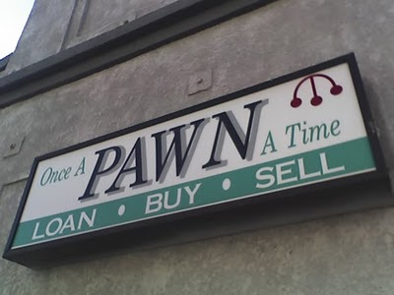
Look at the picture :
What literary term is this
an example of?
a. personification
b. alliteration
c. pun
d. irony

Slide 44
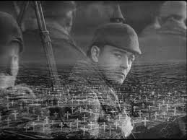
In All Quiet on the Western Front, the company commander is counting how many men are left in the Second Company; "he ceases at thirty-two" men. And has a long pause before asking "anyone else?"
What kind of tone is Remarque
using in this? a. happy b. angry c. confused d. shocked

Slide 45
A Sad Love Story
Read the passage below:
She had a boyfriend with a wooden leg, but she had to break it off.
This is an example of a(n):
a. alliteration
b. pun
c. hyperbole
d. personification

Slide 46
Read the passage from All Quiet on the Western Front by Remarque: "I open my eyes- my fingers grasp a sleeve, an arm. A wounded man? I yell at him- no answer- a dead man. My hand gropes farther, splinters of wood- now I remember again that we are lying in the graveyard....I crawl still farther under the coffin, it shall protect me; though Death himself lies in it." What literary device is used to show the speaker's determination? a. alliteration b. irony c. metaphor d. personification

Slide 47
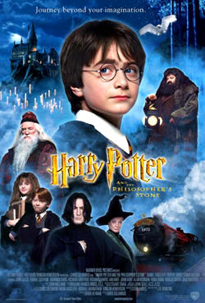
Look at this movie poster:
If you look carefully, you'll see that the title is not Harry Potter and the Sorcerer's Stone, but instead, Harry Potter and the Philosopher's Stone.
This is the original title by the book's author, J. K. Rowling.
When this book was published in England, the title was kept.
When the book was published in the United States, the title was changed to the Sorcerer's Stone.
What is the best reason why this change was made?

Slide 48
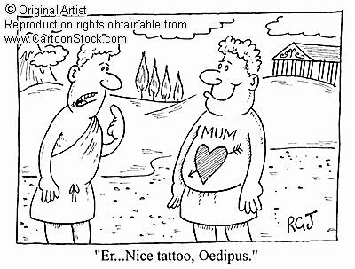
In the play, “Oedipus Rex,” the king is visited by an elderly Messenger from a distant land with important news. Oedipus- “Never, I will never go near my parents.” Messenger- “My boy, it is clear, you don’t know what you’re doing.” Why does the Messenger refer to Oedipus as “my boy?” A. The messenger knows that Oedipus is male B. Oedipus is actually a child C. The messenger has knowledge of events
that Oedipus does not know D. The messenger knows that Oedipus is a Momma’s boy

Slide 49
The Bundle of Sticks An old man on the point of death summoned his sons around him to give them some parting advice. He ordered his servants to bring in a bundle of sticks, and said to his eldest son: "Break it." The son strained and strained, but with all his efforts wasunable to break the bundle. The other sons also tried, but none of them was successful. "Untie the bundle," said the father, "and each of you take a stick." When they had done so, he called out to them: "Now, break," and each stick was easily broken. "You see my meaning," said their father. What is his meaning?
a. together you are stronger b. you will all die like me one day no matter how strong you are c. life stinks d. it is a shame to break good things

Slide 50
With all the bombilation of the students yelling, alarms ringing, and teachers crying, I could not hear the intercom tell us what we were supposed to be doing.
As used in the above passage, what does bombilation mean?
a. an explosion
b. large crowds
c. mass chaos
d. loud noises

Slide 51
Read the following sentences: I tried something that my mom made for dinner. It was so awful that before I realized what I was doing, I expectorated it. My mom was furious with me. The word expectorated as used in the above sentence probably means: a. threw up b. spit out c. swallowed d. chewed it up

Slide 52
Read the following poem by Shel Silverstein from Where the Sidewalk Ends: ALICE
She drank from a bottle called DRINK ME And up she grew so tall, She ate from a plate called TASTE ME And down she shrank so small And so she changed, while other folks Never tried nothin’ at all
The rhyme scheme of the poem is AB AB CB.
Why does the author change the rhyme scheme in line 5? a. He couldn't find another rhyme for ME.
b. To draw attention to the poem's meaning.
c. Because it is an allusion to Alice in Wonderland.
d. To change the pace of the poem.

Slide 53
Read the passage and determine the tone of the author: It was so embarrassing. I spilled my drink in the class. To make matters worse, it spilled on my pants. Then my teacher stopped the whole class to wait while I cleaned it up. I hate it when everyone is staring at me.
What is the speaker’s tone?: a. annoyed b. apathetic c. humiliated d. paranoid

Slide 54
Read the following quotes taken from the Harry Potter books. All quotes are from Hagrid, the giant friend of Harry and his pals who lives outside the castle and is not allowed to use magic like the rest of the characters. "I'm not blamin' yeh...but I gotta tell yeh, I thought you two'd value yer friend more'n broomsticks or rats. Tha's all." "What's comin' will come, an' we'll meet it when it does." "Meant ter turn him into a pig, but I suppose he was so much like a pig anyway there wasn't much left ter do." "Yeh did as much as yer father would've done, an' I can' give yeh no higher praise than that." "Gotta bone ter pick with yeh. I've heard you've bin givin' out signed photos. How come I haven't got one?" "Yer' great puddin' of a son don' need fattenin' anymore, Dursley, don' worry." What is the most likely reason that the author uses this dialect? a. to make Hagrid seem very different from the other characters b. the author can't spell well c. Hagrid is an idiot d. it foreshadows that Hagrid is not to be trusted

Slide 55
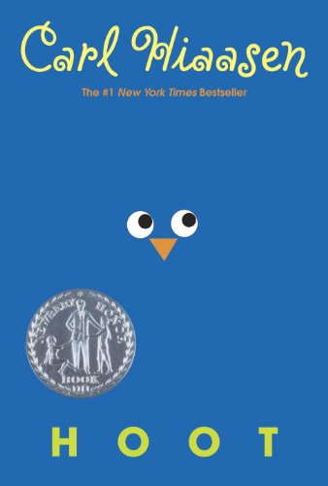
From this excerpt from the book Hoot by Carl Hiaasen
Garret was a D student, but he was popular in school because he goofed around in class and made fart noises whenever a teacher called him out. Garret was the king of fart noises at Trace Middle. He was most famous for farting the first line of the Pledge of Allegiance during homeroom. And Garret's mother was a guidance counselor at Trace.
Which figurative of speech is it using?
A) Simile
B) Personification
C) Irony
D) Metaphor

Slide 56
In Marvel comics, the oath that all Hydra agents take is: "Hail, Hydra! Immortal Hydra! We shall never be destroyed! Cut off a limb, and two more shall take its place! We serve none but the Master—as the world shall soon serve us! Hail Hydra!" What literary term is being used here? a. metaphor
b. allusion
c. archetype
d. hyperbole

